Slide 1


| Tech Management, SRI-B
CLAWS
CLASH OF THE
M S Ramaiah Institute of Technology_XYZz
Cue – your studdy buddy, straight from whatsapp
Vajreshwari, Shreya maran

Slide 2

Idea
The Problem
Most students don't fail because they're lazy. They fail because life gets in the way — and by the time they realize they're behind, it's the night before the exam. Cue is built for exactly that student. The one who means to study but keeps pushing it. The one who pulls all-nighters not by choice, but because nothing warned them early enough.
Nobody reminds them to study until it's too late
Study material is scattered across PDFs, drives, and notes
Generic apps don't understand their schedule, their syllabus, their bad days
Every tool requires opening an app, logging in, navigating a dashboard

Slide 3
Idea
Current Solution & Gaps
Existing Solutions
• ChatGPT/Gemini require users to open apps manually
• Productivity tools are fragmented across platforms
• Reminder/calendar apps need constant manual input
What’s Missing
• No proactive AI inside students’ daily workflow
• AI tools respond, but rarely take real actions
• Lack of persistent context about schedules, syllabus, and progress
Opportunity
• Turn WhatsApp into a real AI assistant layer
• Create a proactive, local-first student companion
• One conversational interface for reminders, workflows, and automation
“Students don’t need another chatbot. They need an AI that actually participates in their life.”

Slide 4
Idea
Your Solutions
CUE is a proactive AI study companion that lives inside WhatsApp and helps students stay consistent without needing separate productivity apps.
Key Features
• Personalized study schedules based on syllabus and exam dates
• Daily study material delivered automatically at study time
• Adaptive planning based on user activity and routine changes
• Emotion-aware responses for stress, burnout, and procrastination
• Emergency exam mode for last-minute preparation
• Local-first AI workflow powered by OpenClaw + Gemini 2.5 Flash
Core Idea
Instead of waiting for students to ask for help, CUE actively supports them through reminders, study guidance, and real-time workflow assistance directly inside a familiar messaging platform.

Slide 5
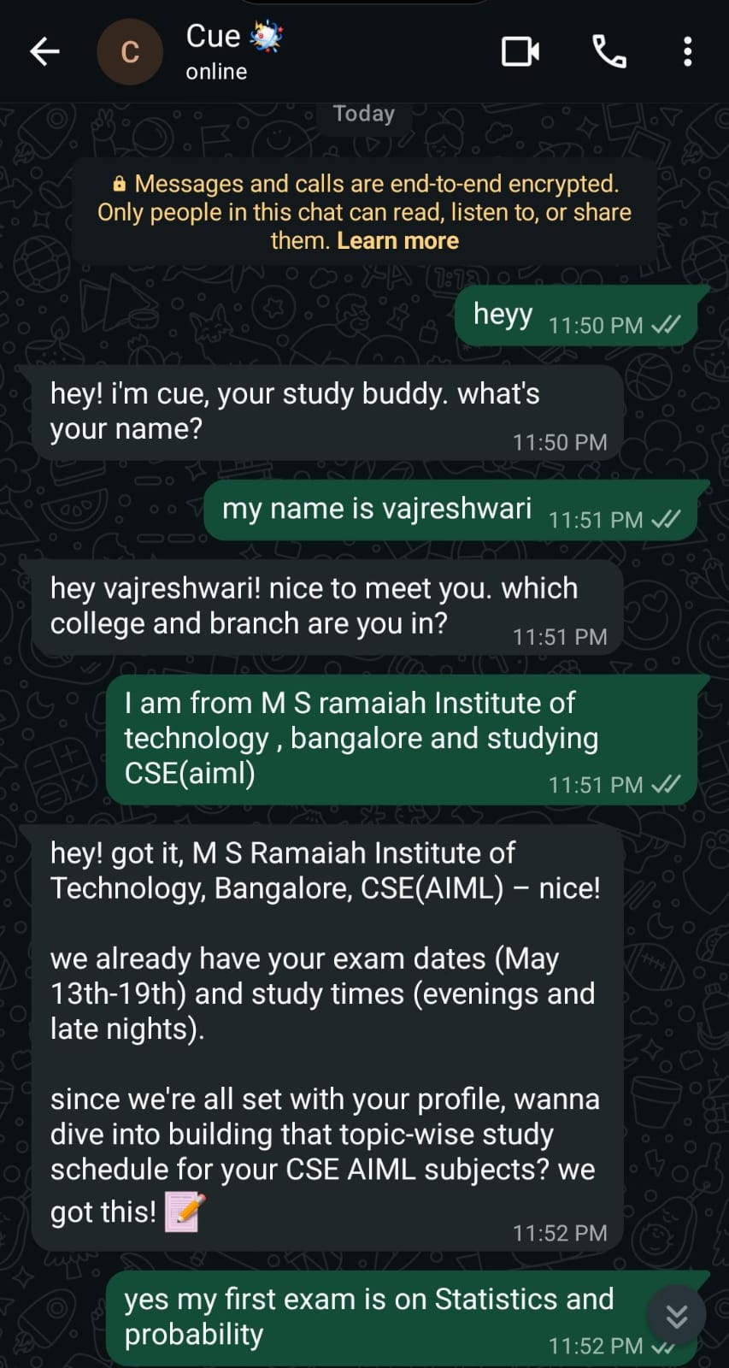
Idea
Demo/Product Walkthrough

Slide 6
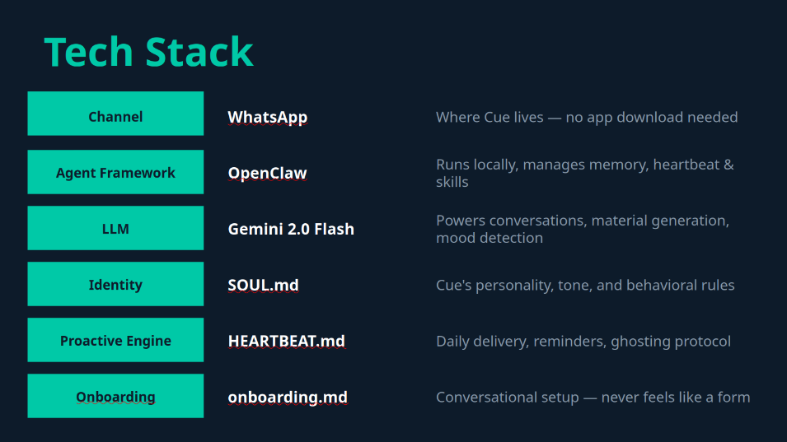
Idea
Tech & Architecture

Slide 7
Idea
Impact & Use cases
Real-Life Use Cases
• Daily study reminders for students
• Emergency exam preparation mode
• Personalized study scheduling
• Motivation and burnout support through WhatsApp
Impact Potential
• Makes AI accessible through familiar messaging apps
• Reduces procrastination and missed study plans
• Scalable for classrooms, coaching centers, and colleges
• Creates a more personal and proactive learning experience

Slide 8
Idea
Differentiation
What Makes Cue Different
• Lives inside WhatsApp — no separate app needed
• Proactive AI that reaches out before users ask
• Personalized interaction based on student behavior and routine
• Combines study planning, reminders, and motivation in one system
Strong Moat
• Familiar messaging-based experience increases daily usage
• Local-first AI workflow allows deeper personalization and flexibility

Slide 9
Idea
Demo Link
GitHub Repo
AI CLOSURE: file:///home/vajra/CUEEE%20IMPPPP/OpenClaw_AI_Disclosure__1_.docx

